Slide 1
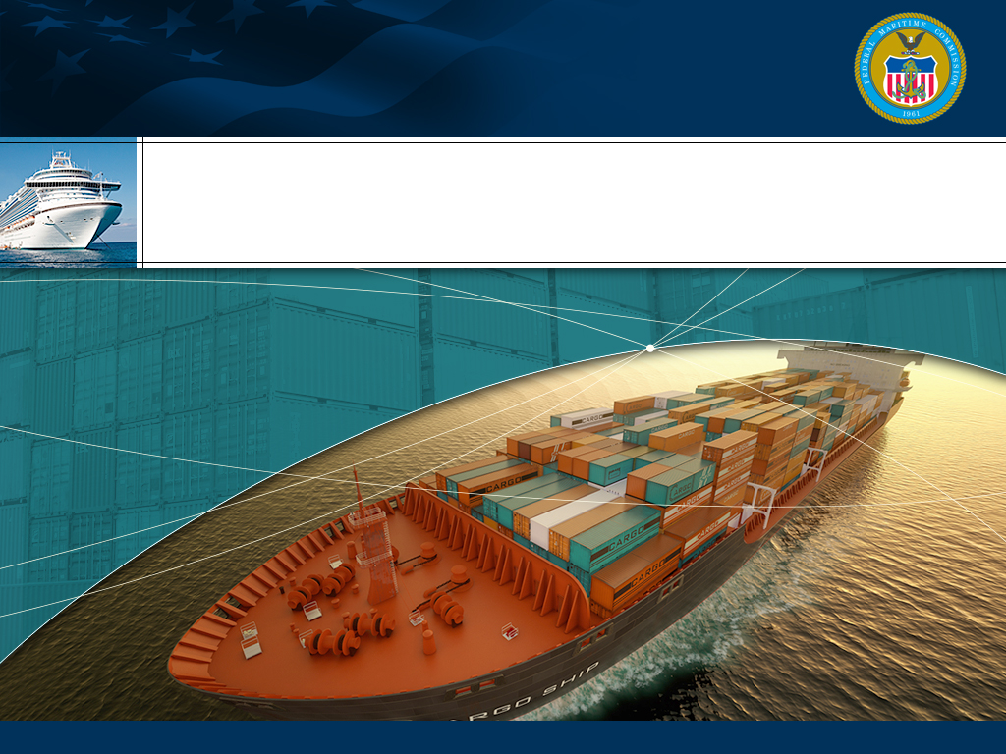

Ocean Transportation Intermediary License Renewal System February 2017

Slide 2

Ocean Transportation Intermediaries (OTIs)
Ocean Freight Forwarders and NVOCCs
As of January 26, 2017 there are 4,829 licensed OTIs
OTI Licenses are to be renewed every 3 years
License renewal process
  No Fee and on-line
  Phased-in over a three year period – approximately 160 renewals per month.
  The first email notifications (90-days prior to the renewal deadlines) will be sent from oti@fmc.gov in early March 2017. Notifications are automated – check junk mail if you don’t receive a notification.
  The first renewal deadlines are May 31, 2017
  An OTI can designate a third party to complete the renewal on their behalf so long as the third party is an FMC Practitioner or an Attorney
  Email notification will be sent directly to the OTI. Tariff Publishers will also receive notifications for their NVOCC clients.
  The month & year of renewal deadlines are determined by the last and next to last digit in the license number.
Footer text goes here

Slide 3
Determining a Renewal Date
FMC License number ending in: | Must file by last day of:
1 | January
2 | February
3 | March
4 | April
5 | May
6 | June
7 | July
8 | August
9 | September
0 | October
Next to Last Digit of FMC License | Renewal Year
1,2,3 | 2017 | 2020 | 2023 | 2026 | 2029 | 2032 | 2035
4.5.6 | 2018 | 2021 | 2024 | 2027 | 2030 | 2033 | 2036
7,8,9,0 | 2019 | 2022 | 2025 | 2028 | 2031 | 2034 | 2037
The OTI list found on the FMC website has the specific renewal date for each OTI.
http://www2.fmc.gov/oti/

Slide 4
Ocean Transportation Intermediaries (OTIs)
Ocean Freight Forwarders and NVOCCs
Messages will be sent to the primary email address on file until the renewal is completed.
  90, 60, 30, and 15 days prior to the renewal deadline (to the OTI & Tariff Publisher)
  On the Renewal deadline date (to the OTI & Tariff Publisher)
  15 days past renewal (to the OTI & Tariff Publisher)
  30 days past – notice of intent to revoke the license
The OTI email notification(s) will contain
  USERNAME
  PASSWORD
  LINK TO THE RENEWAL SYSTEM
Upon receipt of this email message the OTI will be able to log on to the renewal system. Renewal should be completed no later than the renewal deadline date shown on the FMC website. The OTI can designate a third party to complete the renewal.
Footer text goes here

Slide 5
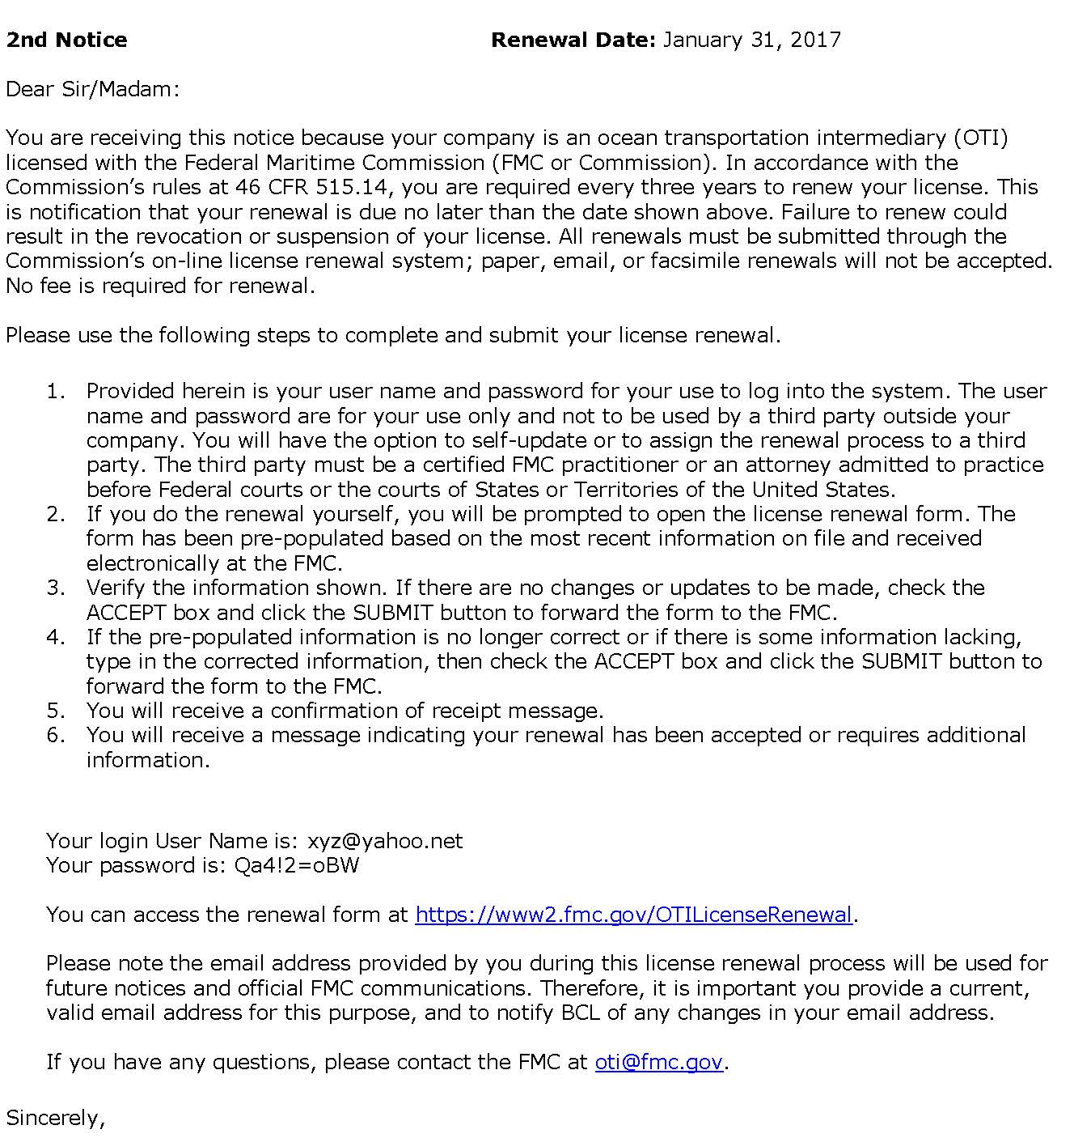

Slide 6
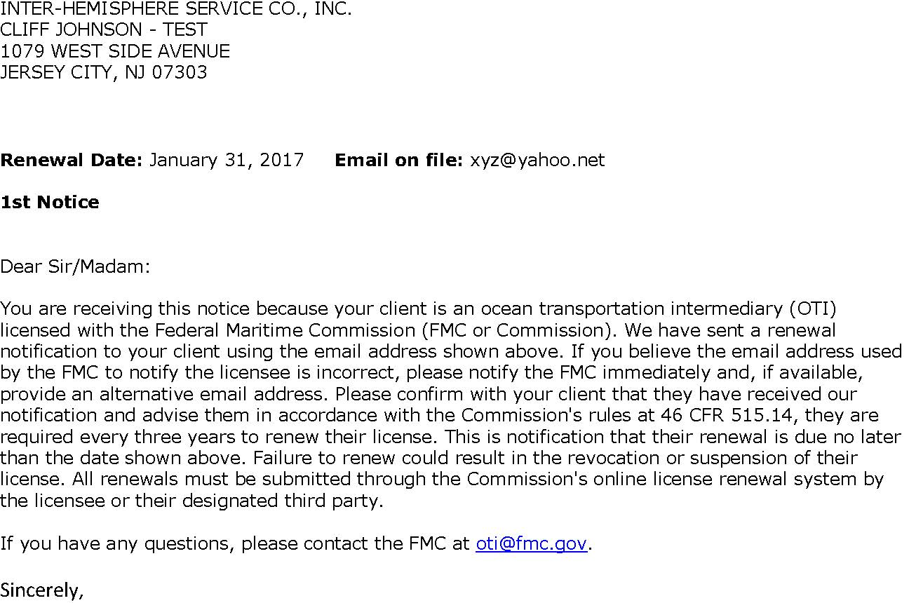
External User – Email Notification
For NVOCCs ONLY – the Tariff Publisher will receive notifications
But no action can be taken by the publisher until designated by the OTI
To: Tariff Publisher via email
NAME OF OTI COMPANY
123 MAIN STREET
CAPITAL CITY, CA 91234

Slide 7
External User Login
Login - Form 18 OTI License Renewal
Login
User Name:
Password:
Reset Password
For any questions contact us at OTI@fmc.gov or telephone #202-523-5843.

Slide 8
External User
View with multiple entities
The Status may be
Current, Assigned, or
Submitted
Click on the OTI to be updated
An external user, such as a third party filer or an entity with multiple licenses, will see all of “their” entities listed. Click on the entity to be processed.

Slide 9
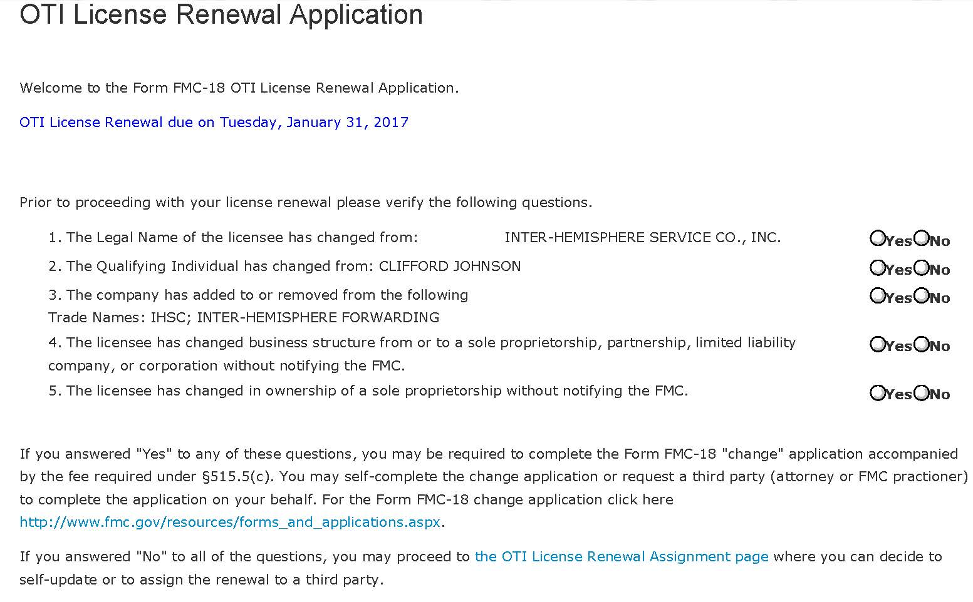
External User – Initial Questions
Legal Name / Qualifying Individual / Trade Names / Structure / Ownership
If the answer is YES to any of these questions a “change application” is required before renewal
A legal name change
due to marriage or any
other reason is not a change
If any question is answered “yes”, click here
and proceed to the change application
If all questions are answered “no”
Click here

Slide 10
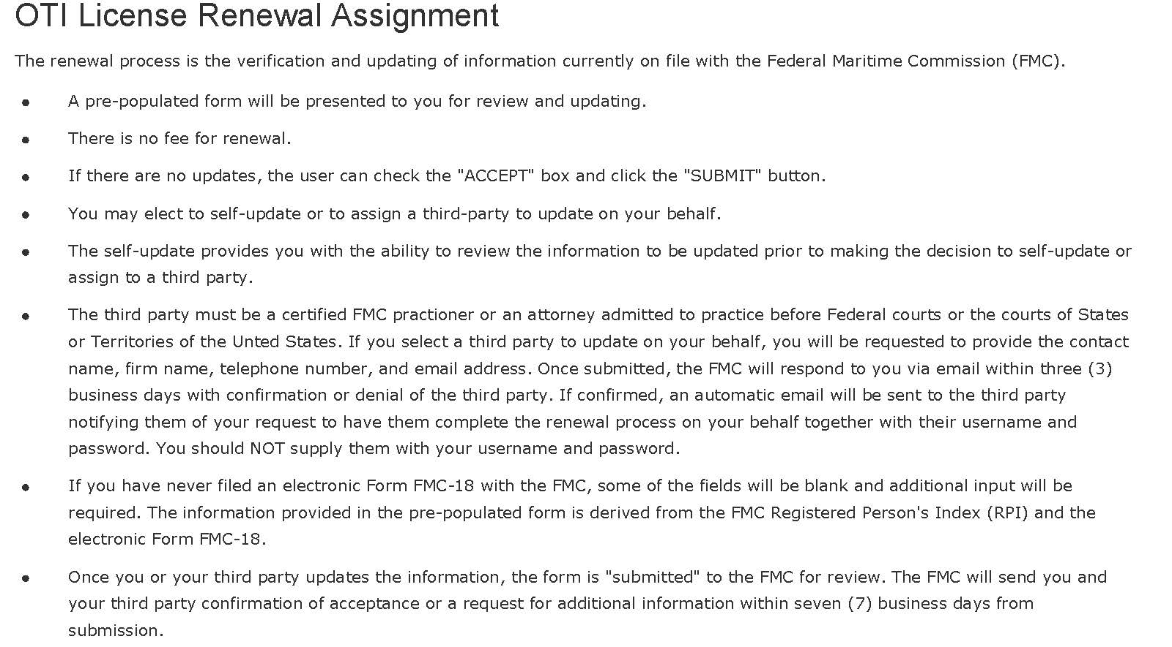
External User
Third Party Renewal Assignment
CLICK ONE OF THESE TWO BOXES
View or Edit License Renewal
Request Third Party to Complete Renewal
The OTI can view only before deciding to self renew or to assign to a third party, but once the third party is selected the renewal is locked to the OTI

Slide 11
External User
Requesting a Third Party to complete the renewal
Request Third Party Complete Renewal
Firm Name:
Contact Name:
Contact Email:
Telephone Number:
Your third party may already be preapproved for renewals. Ask your third party if they have an email address they normally use with FMC systems (i.e. FMC1, FMC18). If the email address associated with our systems is entered here the approval should be automatic.

Slide 12
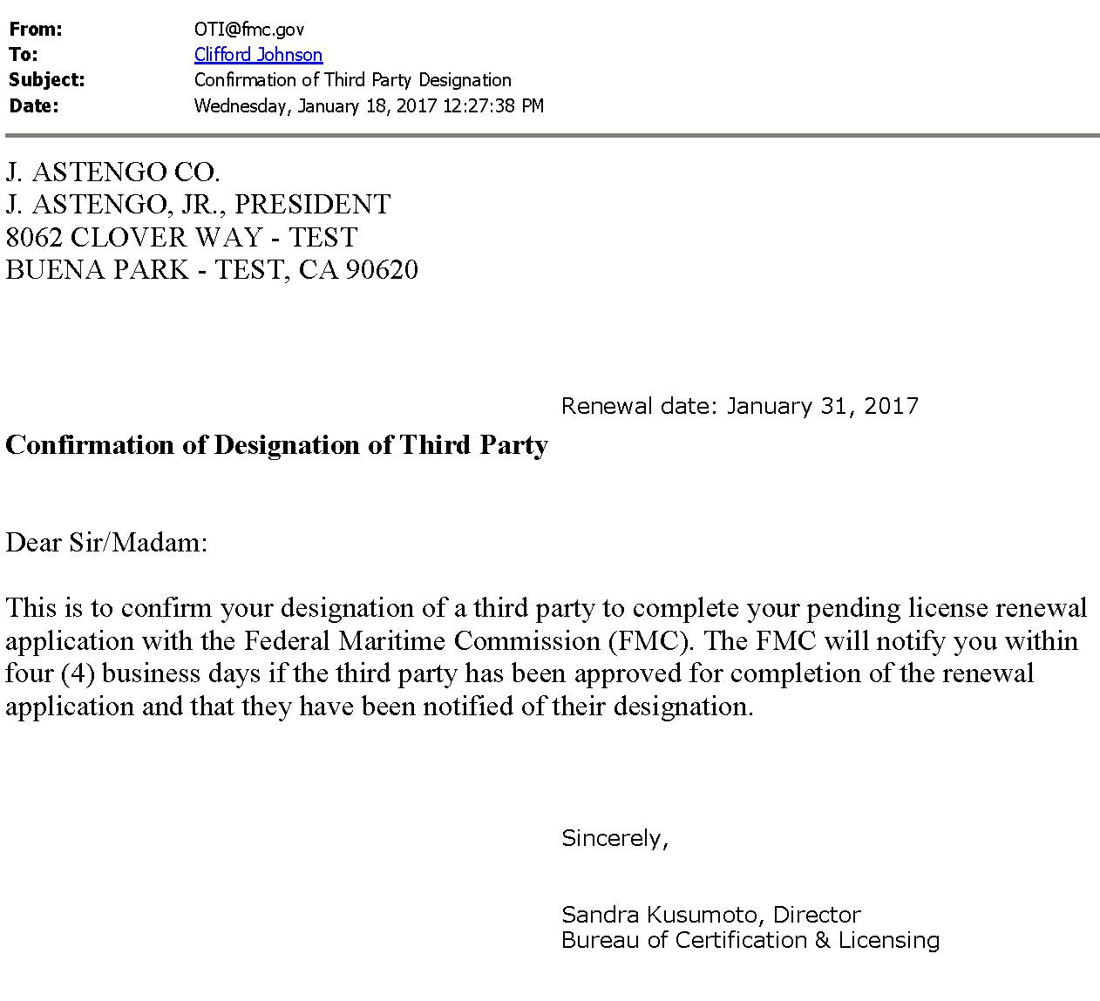
External User - Email Notification
Confirmation of Designation of Third Party
OTI INC.
OTIS SMITH, JR.
8062 CLOVER WAY
GARDEN PARK, CA 90990

Slide 13
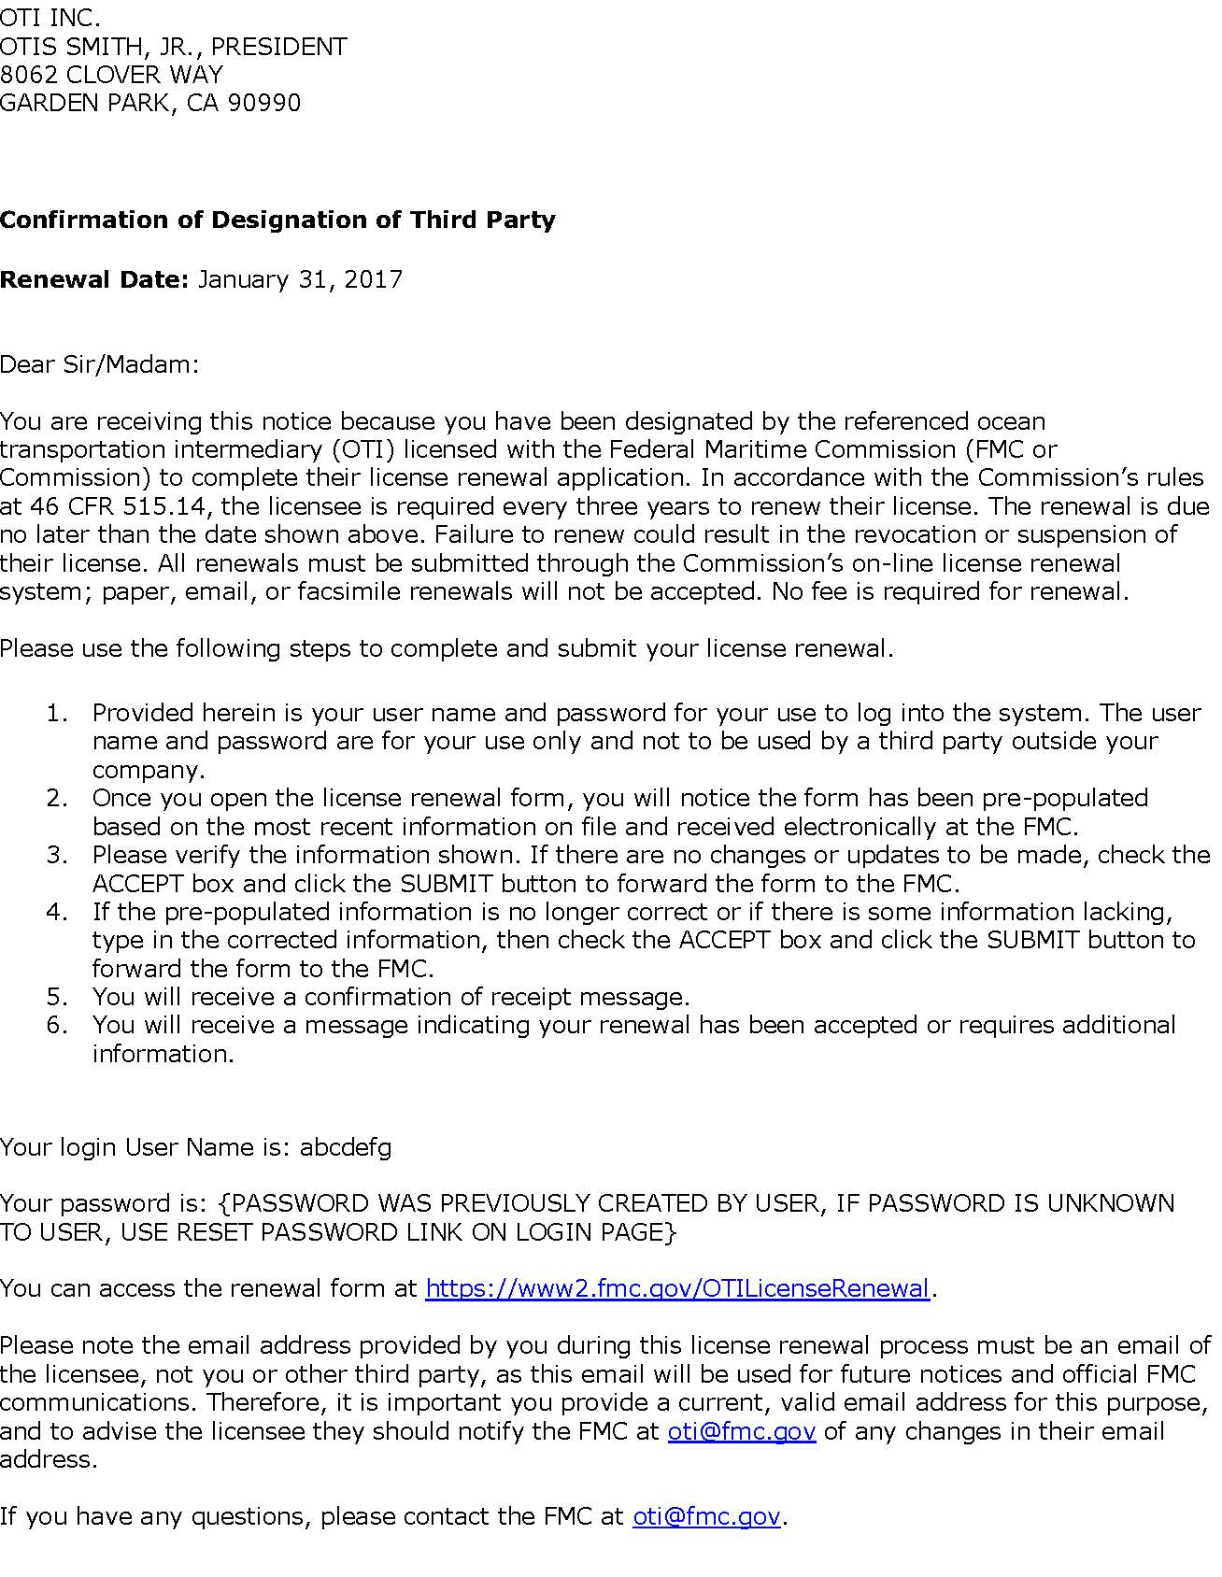
External User
Notification received by Third Party

Slide 14
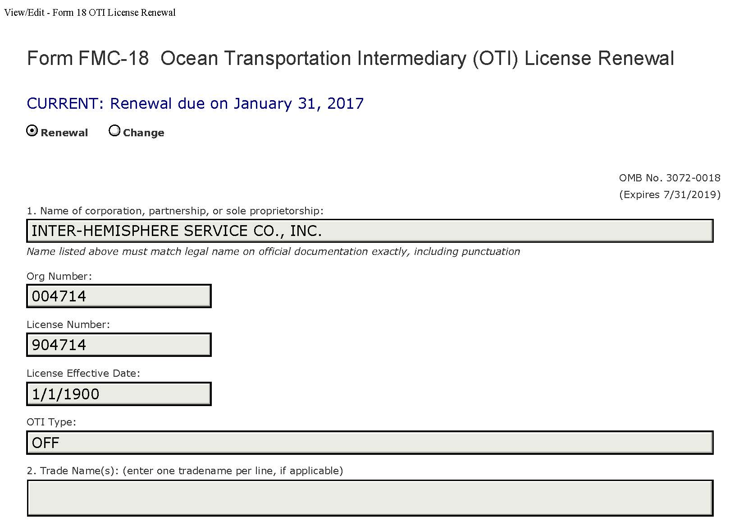
External User- Update View
1. Name of Corporation & 2. Trade Names
CAN NOT BE UPDATED AS PART OF THE RENEWAL PROCESS
These fields are “greyed out” and can not be updated.
Changes to these fields require a “change application”

Slide 15
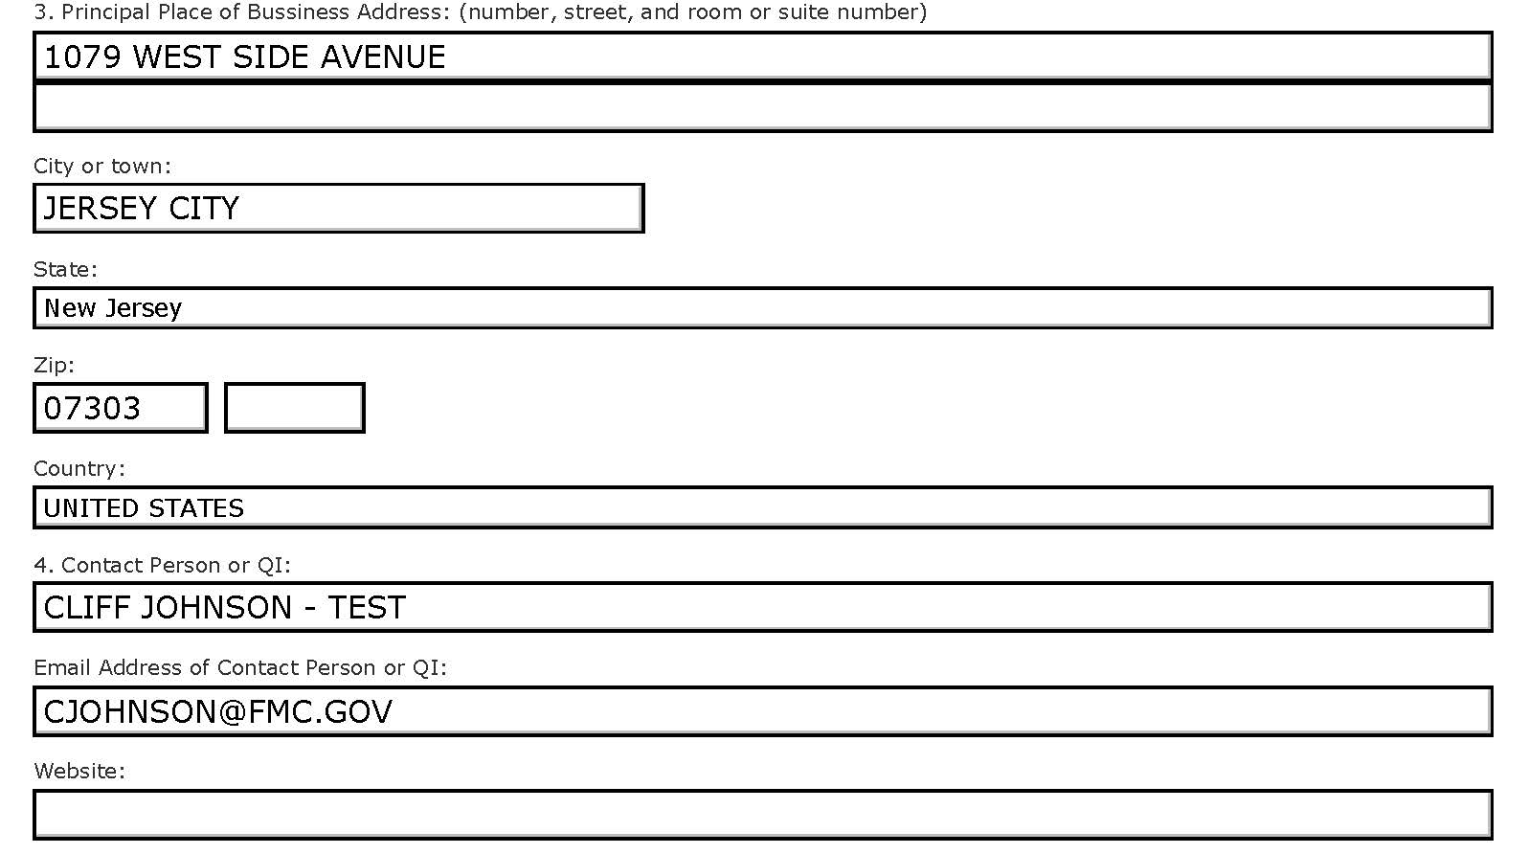
External User – Update View
3. Address / 4. Contact Person
OTIS SMITH
OTIS@OTISSHIPPING.COM
WWW.OTISSHIPPING.COM
The email address entered here will be used for all FMC official notifications and must be for the licensee NOT a third party.

Slide 16
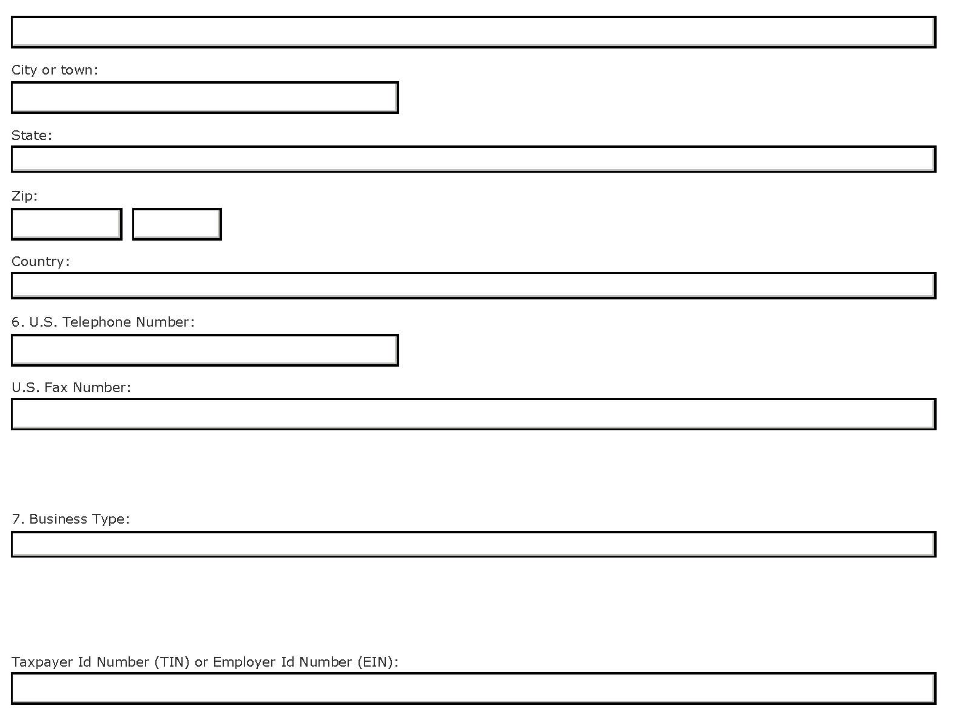
External User – Update View
5. Mailing Address (if different) / 6. Phone / 7. Business Type & TIN
Sole Proprietorship
LLC
LLP
Corporation
Drop down selection

Slide 17
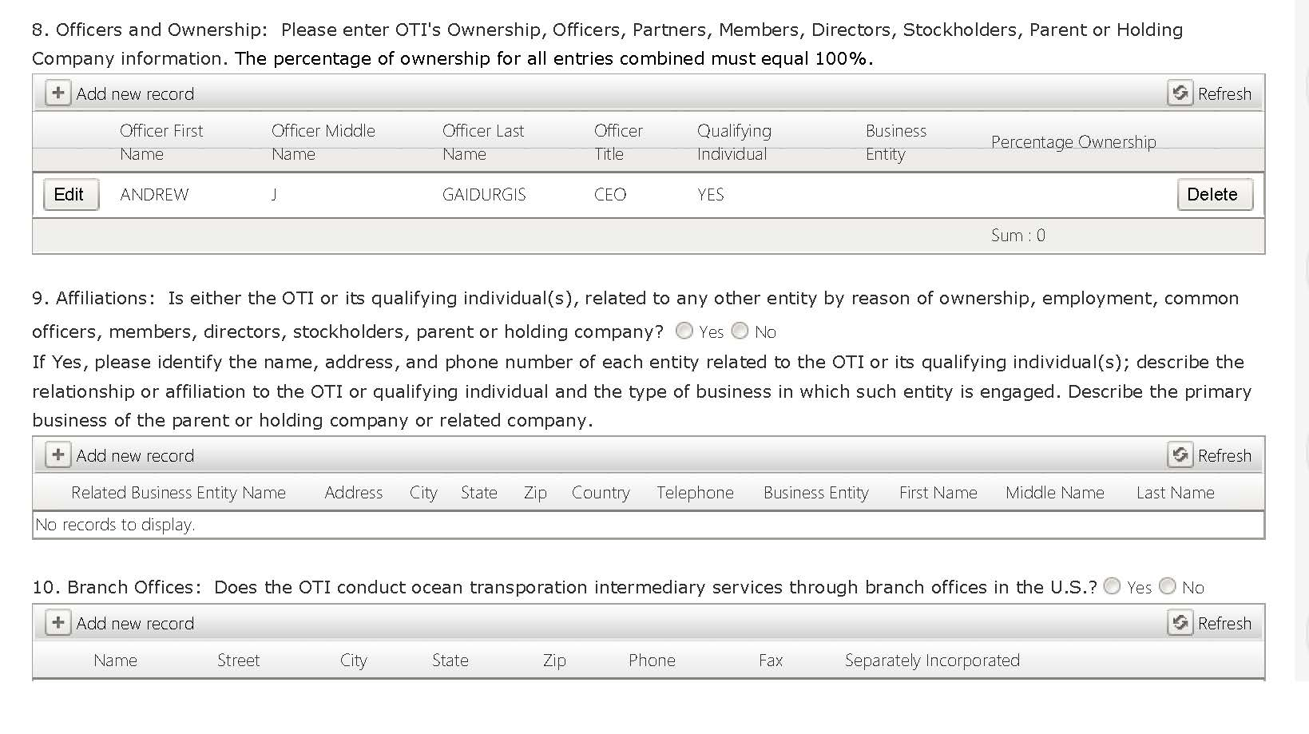
External User – Update View
8. Officers and Owners / 9. Affiliations / 10. Branch Offices
ADD, EDIT, OR DELETE AN OFFICER, AFFILIATION, AND/OR BRANCH OFFICE

Slide 18
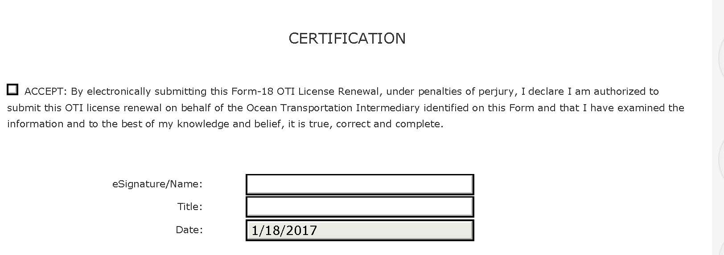
External User – Update View
Certification
Certification the information is correct
Save Draft
Submit
Quit
Save Work &
Return later
Ready to go
Leave without saving

Slide 19
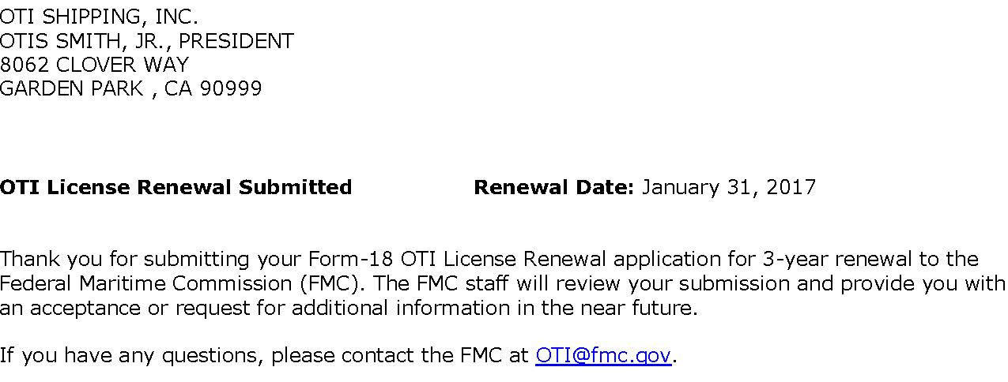
External User
Renewal Successfully Submitted

Slide 20
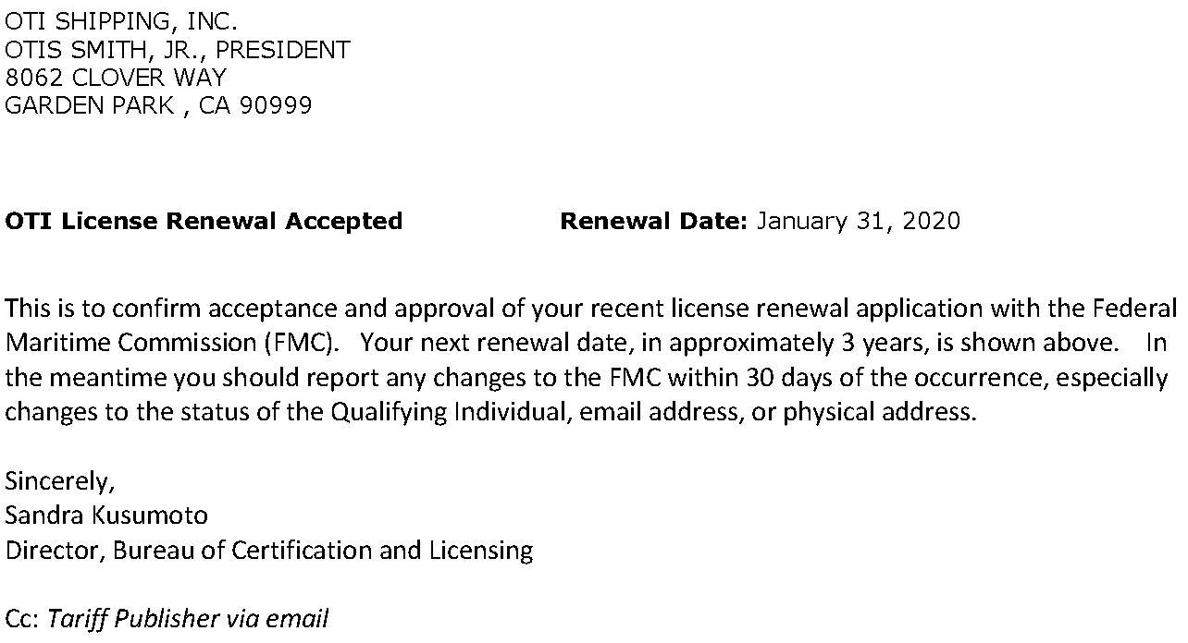
External User
Renewal Accepted

Slide 21
QUESTIONS?
Footer text goes here

